Slide 1
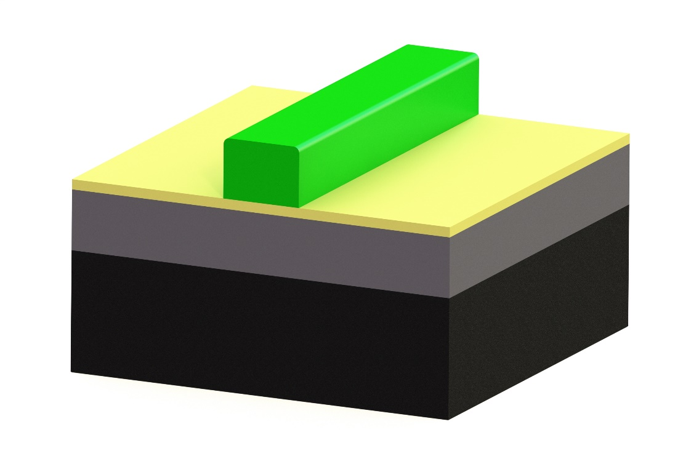
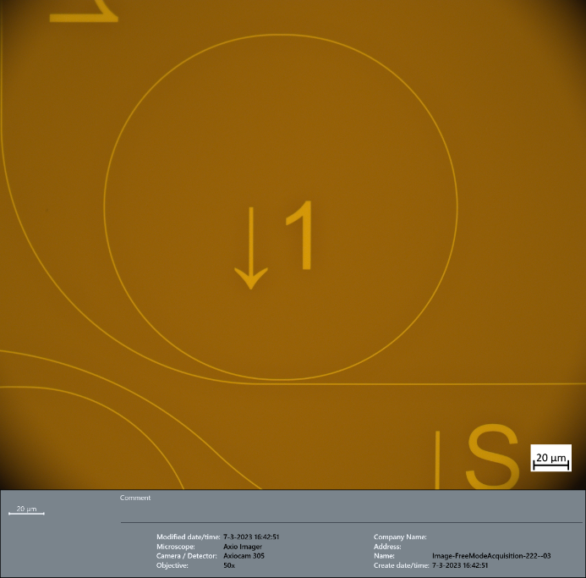
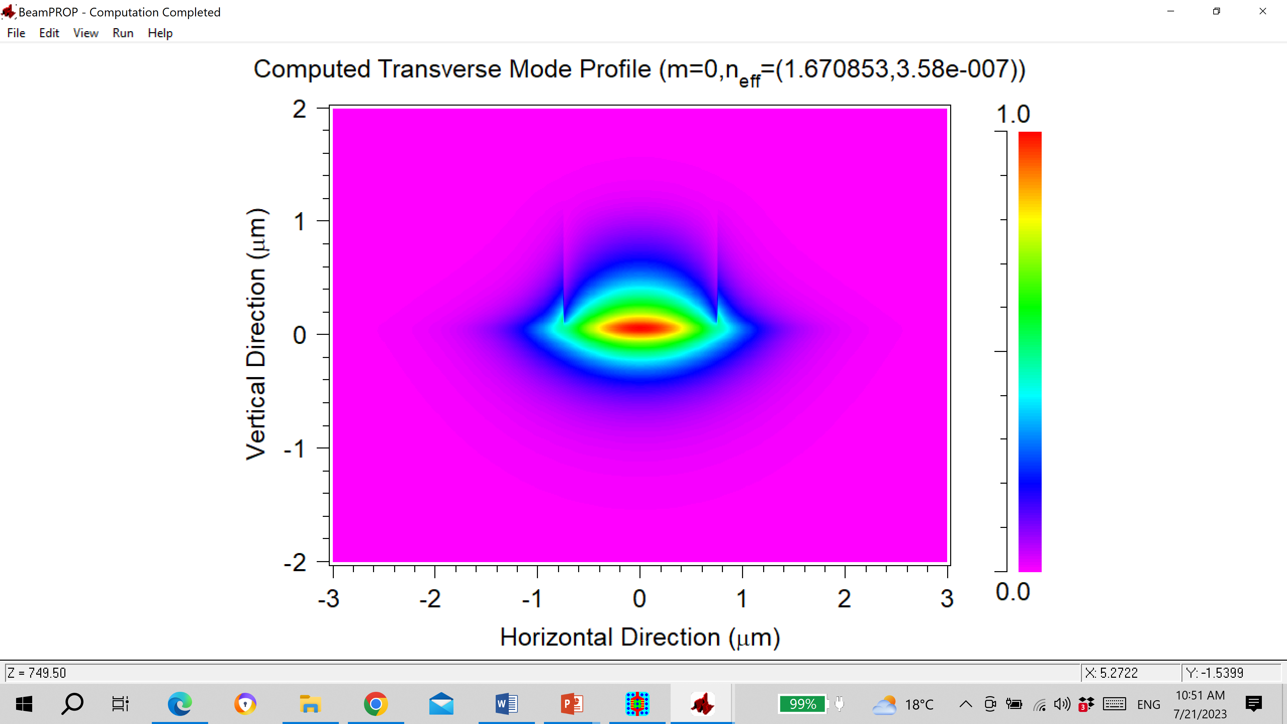
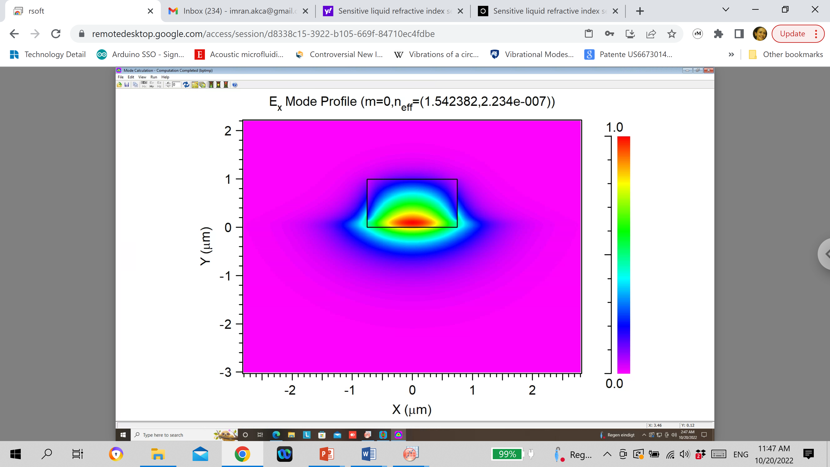
(a)
(c)
(d)
w
SU8
t_{p}
t_{g}
a:SiC
SiO₂
20 µm
500 nm
Si
(e)
2
(b)
1.0
(b)
y (µm)
0
-2
-3
0
3
0
x (µm)

Slide 2
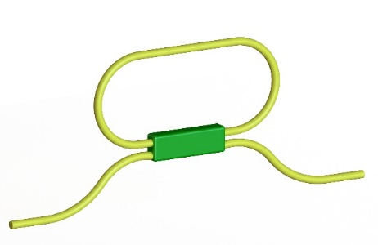
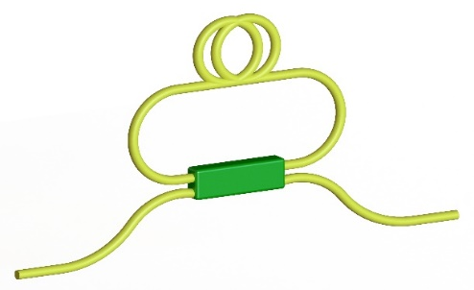
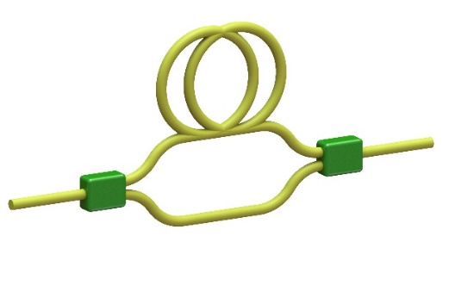
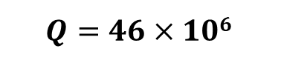
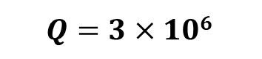
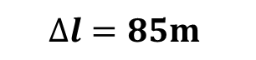
(a)
$$Q=3×106$$
$$Q=46×106$$
(a)
(b)
(c)
$$∆l=85m$$

Slide 3
(a)

Slide 4
(a)
(b)
(c)

Slide 5
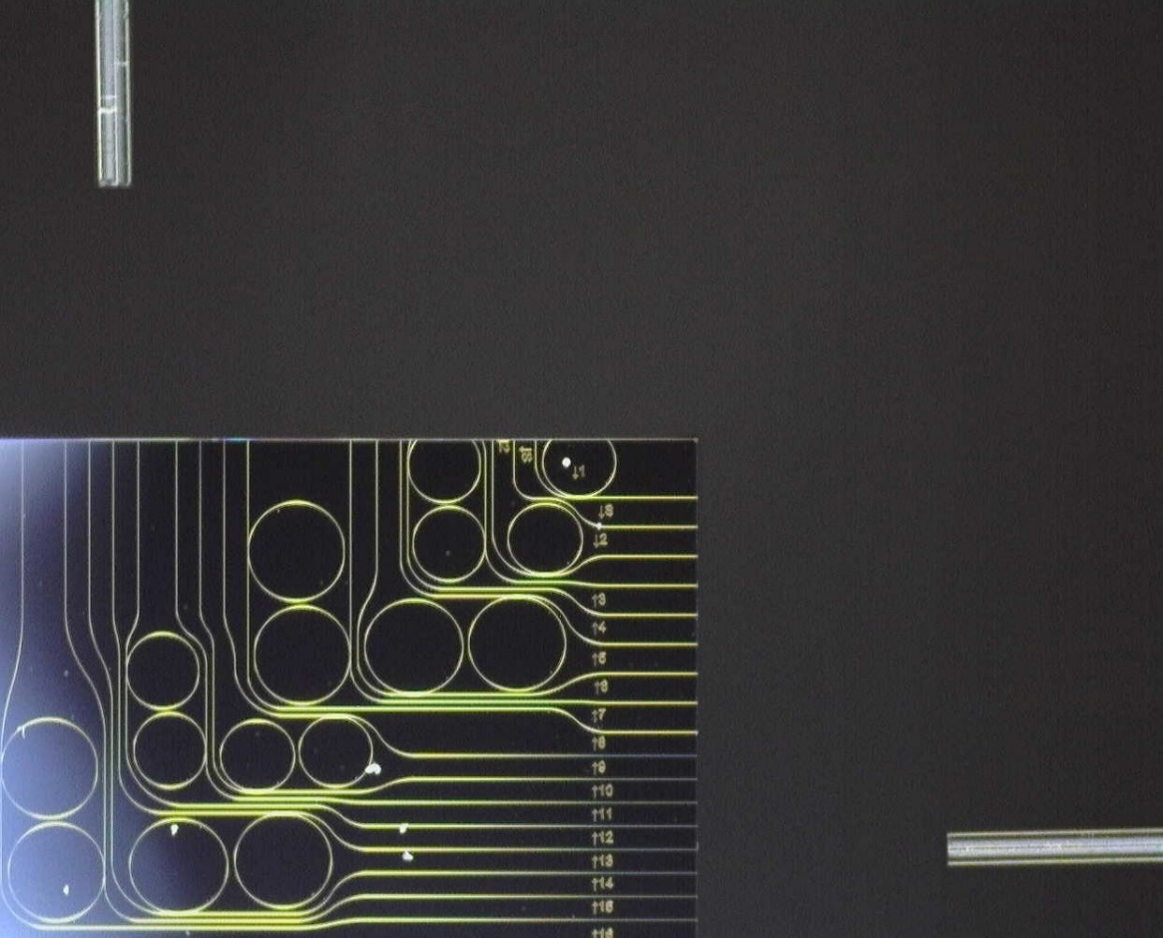
(a)
(b)
Input fiber
$$500 μm$$
Photonic
Microchip
Output fiber

